Slide 1
Operating Systems
Dr. Deepak Dembla

Slide 2
File System Implementation

Slide 3
Objectives
Layered Structure for File System
On-disk file system implementation data structures
In-memory file system implementation data structures
File mapping on disk
Implementation of file related operations
File allocation methods: Contiguous, Linked, Indexed
Free space management
Directory implementation
Backup and recovery methods for file system
File inconsistencies and the checks against them
File System performance issues
Log structured file system

Slide 4
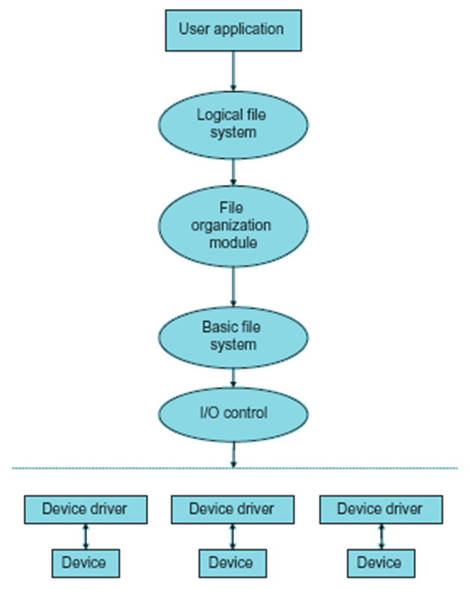
File system structure
Layered structure of the file system

Slide 5
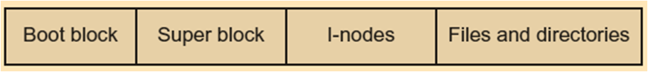
Implementation data structures
Disk layout implementing the file system

Slide 6
The Superblock information
File system identifier: It is also known as a magic number that uniquely identifies the file type
Number and size of data blocks in the file system
Addresses of the free blocks
Free block count
Free FCB count
Addresses of FCB
Address of the root directory
Date and time of last modification to the file system

Slide 7

In-memory data structures implementing the file system
In-memory data structures implementing the file system

Slide 8
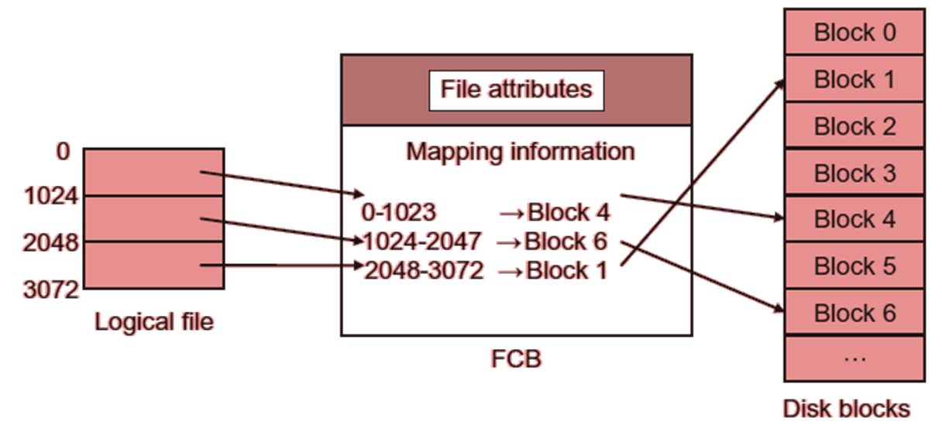
File mapping through FCB

Slide 9
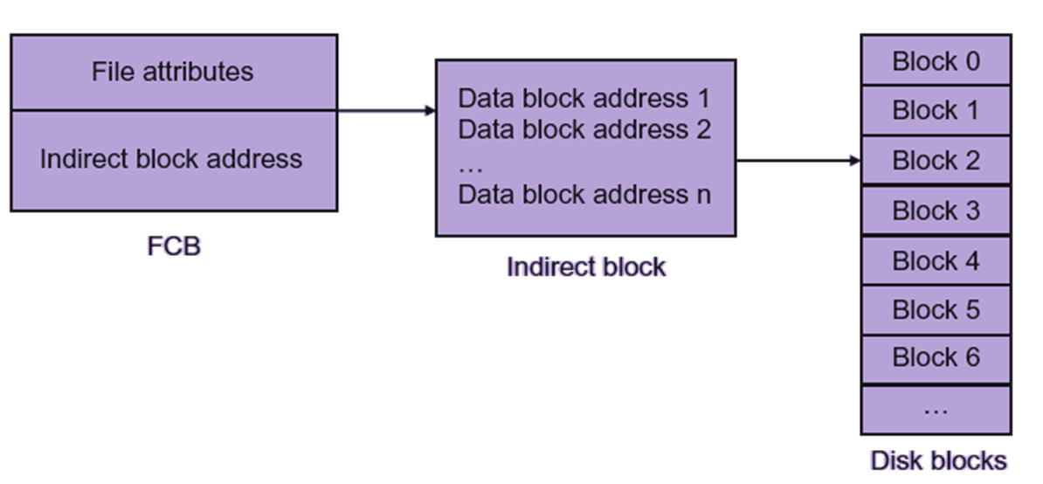
File mapping through indirect block

Slide 10
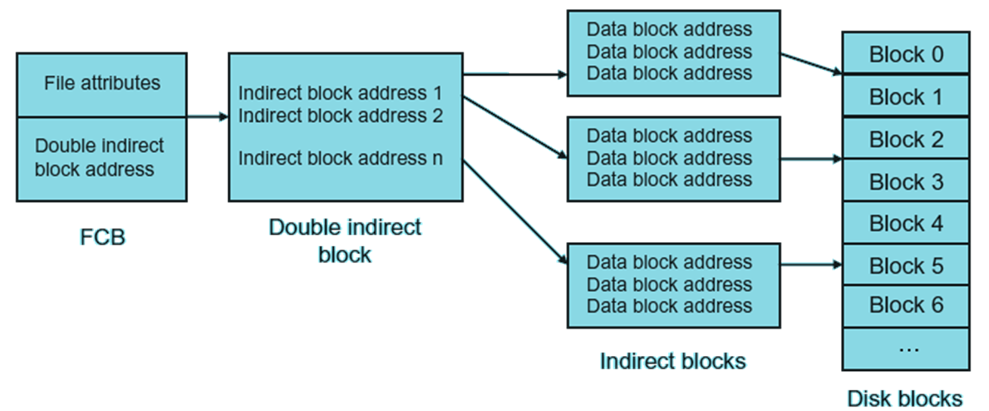
File mapping through double indirect block

Slide 11
Extents
An extent is a compact way to refer to large amount of data represented in the form of pointer-length pair where the pointer is the address to the start address of the range of the blocks and the length is the number of blocks.

Slide 12
File Allocation methods
Contiguous File Allocation
Linked/Chained File Allocation
Indexed File Allocation

Slide 13
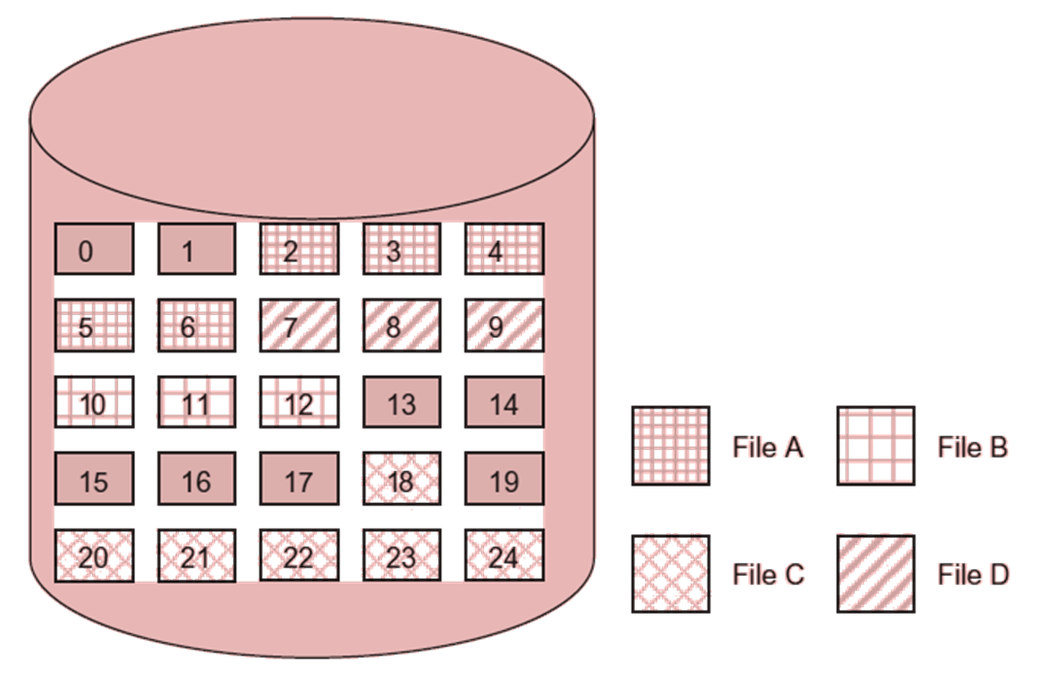
Contiguous file allocation

Slide 14
Contiguous file allocation
File name | Start address | Length
C:/project/OS/FileA | 2 | 5
C:/project/OS/FileB | 10 | 3
C:/project/OS/FileC | 18 | 7
C:/project/OS/FileD | 7 | 3

Slide 15
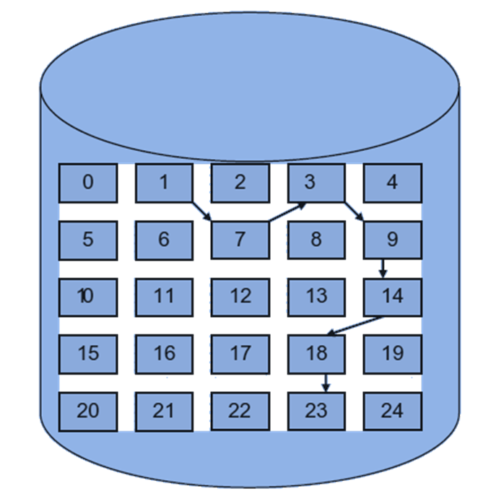
Linked file allocation

Slide 16
Linked file allocation
File name | Start address | Length
C:/project/OS/FileE | 1 | 7

Slide 17
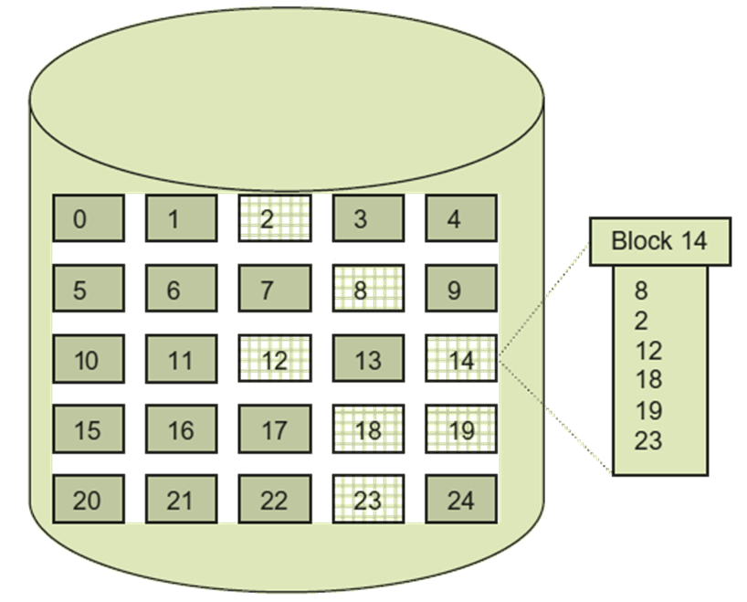
Indexed file allocation

Slide 18
Indexed file allocation
File name | Index Block Address
C:/project/OS/FileF | 14

Slide 19
Free space management
A free space list is a data structure we can place the information which disk blocks are currently free. After allocation a free disk block to a file, the entry corresponding to that block is removed from the free space list. When a file is deleted, the disk blocks corresponding to that file are added to the free space list.
The bit map is a data structure used to implement the free space list by showing the status of a disk block with binary values.

Slide 20
Backup and Recovery
There are three types of backup: physical, logical and incremental.
In physical backup, the copying of data on backup medium is done without any interpretation of where the file belongs. In other words, there is no meta data information about the files or logical structure of the file system.
Logical backup has the interpretation of the files which need to be copied as backup.
Incremental backup takes the backup of only those data which has been changes since the last backup.

Slide 21
Log structured file system
LFS aims to improve the disk-write performance by writing all modifications to disk sequentially in a log structure thereby avoiding all disk-seeks.
The log is a sequential structure on the disk to store the last updates. A log-structured file system stores data permanently in the log.
A log consists of a series of segments where each segment contains file data and its meta data information.
The log contains indexing information so that files can be read back efficiently.
A log structured file system gathers a segment worth of data in memory and appends the segment at the end of the log.

Slide 22
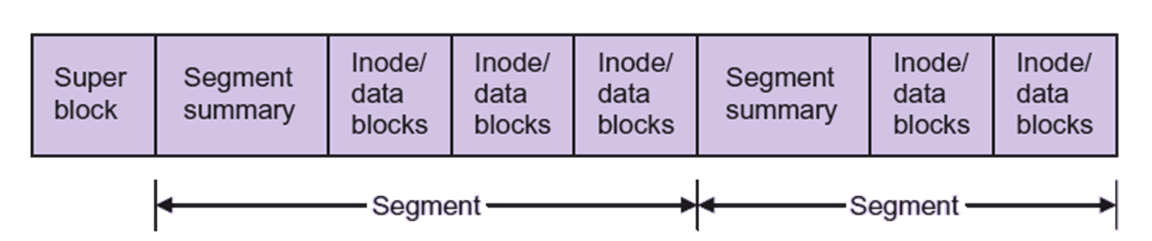
General layout of LFS

